Slide 1

IoT Army of 300
Resource Development to enable Our Brightest Minds in Technology
Abdur Rahman
Lecture 5
Interfacing 7-segment Display with Atmega32
Nov 29, 2017

Slide 2
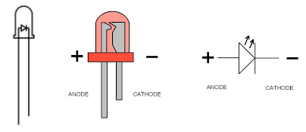
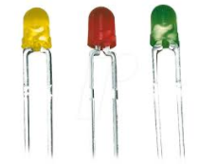
Led

Slide 3

7-Segment
Slides created by:
Abdur Rahman
abdurrahman.iit@gmail.com

Slide 4

7-Segment
Slides created by:
Abdur Rahman
abdurrahman.iit@gmail.com

Slide 5

7-Segment
Slides created by:
Abdur Rahman
abdurrahman.iit@gmail.com

Slide 6

7-Segment
Slides created by:
Abdur Rahman
abdurrahman.iit@gmail.com

Slide 7
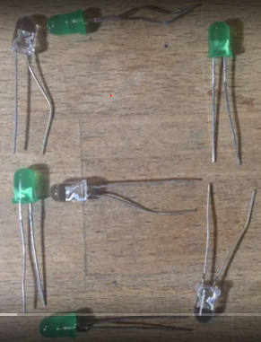
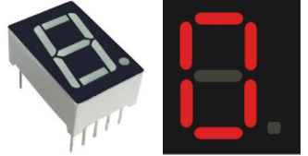
7-Segment display??

Slide 8
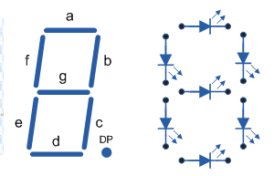
7-Segment display
Seven segment displays are used to indicate numerical information. Seven segments display can display digits from 0 to 9 and even we can display few characters like A, b, C, H, E, e, F, etc. These are very popular and have many more applications. Seven segment displays internally consist of 8 LEDs. In these LEDs, 7 LEDs are used to indicate the digits 0 to 9 and single LED is used for indicating decimal point.

Slide 9
7-Segment display
Seven Segment is of two type
Common Cathode
Common Anode
What is CATHODE and ANODE ?

Slide 10
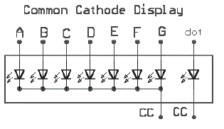
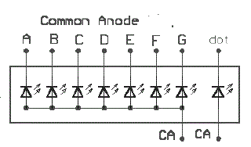
7-Segment display
In common cathode, all the cathodes of LEDs are tied together and
labeled as com. and the anode are left alone.
In common anode, seven segment display all the anodes are tied together and cathodes are left freely.

Slide 11
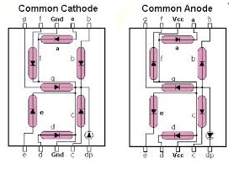
7-Segment display

Slide 12
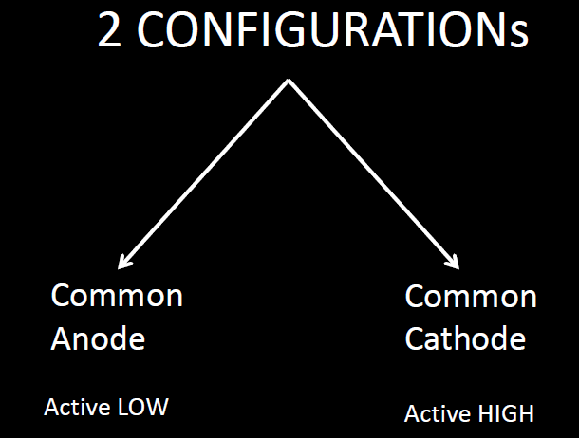

Slide 13
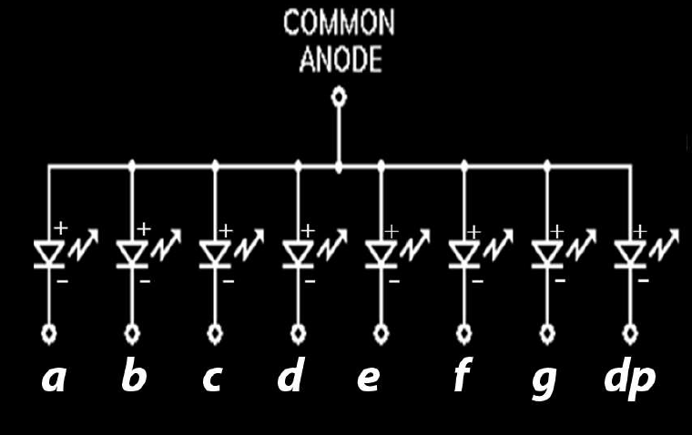
7-Segment display

Slide 14
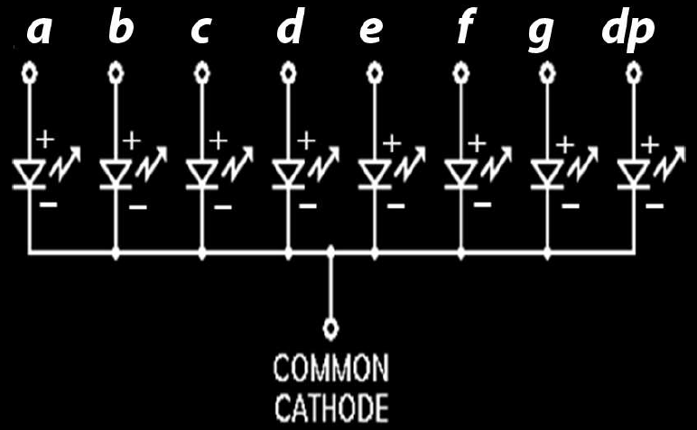
7-Segment display

Slide 15
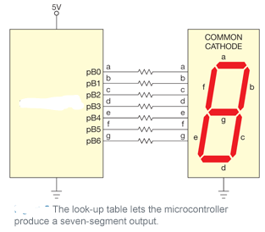
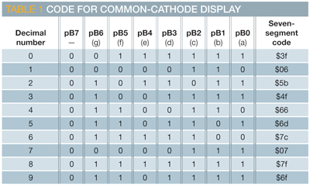
7-Segment display

Slide 16
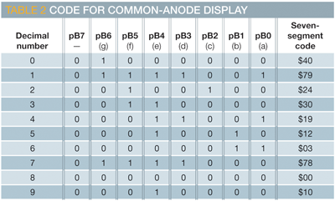
7-Segment display

Slide 17
Video Tutorial:
https://www.youtube.com/watch?v=nVp4j9kCVD0

